Slide 1
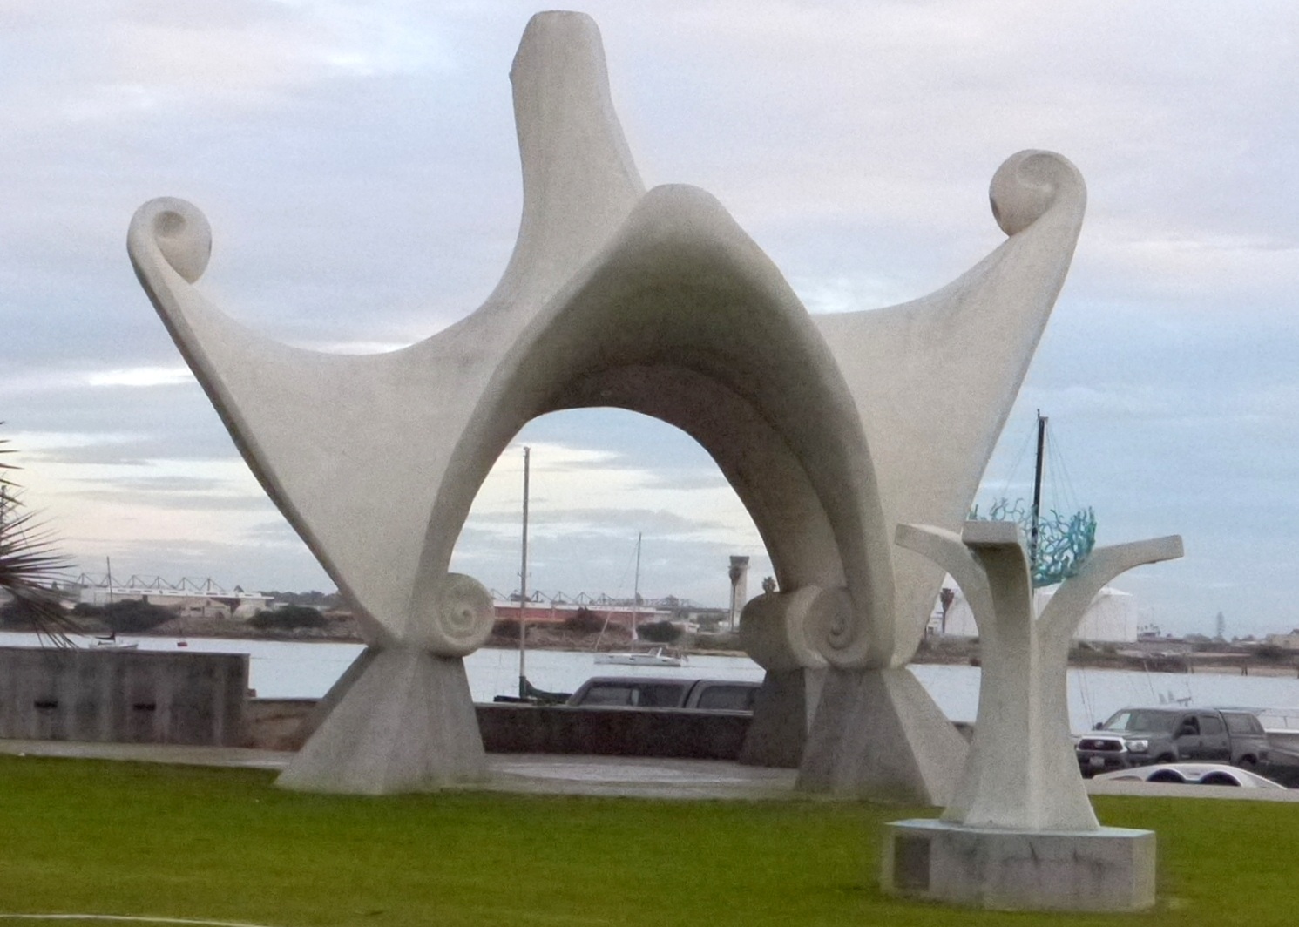
Pacific Portal. Looking east.

Slide 2
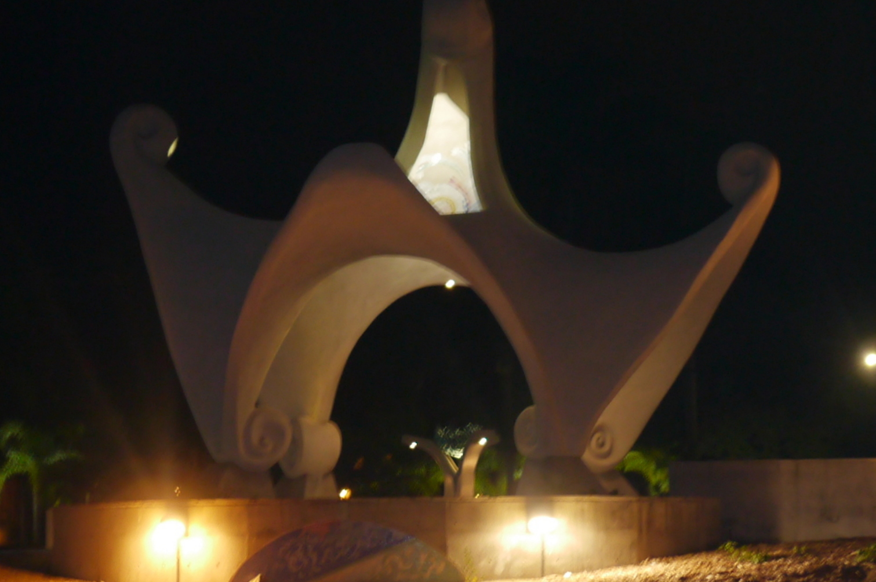
Pacific Portal, at night.
Looking west.

Slide 3
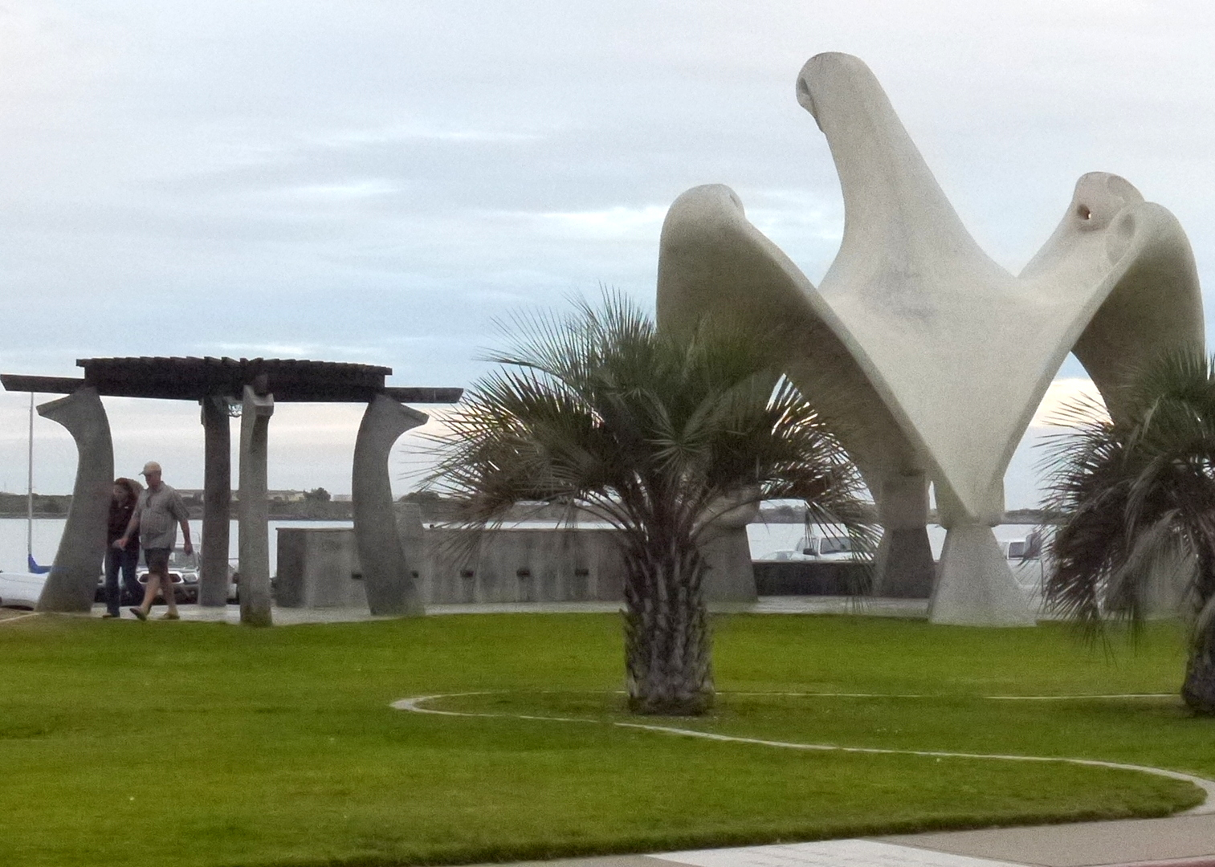
Pacific Portal, with pavilion.
Looking southeast.

Slide 4
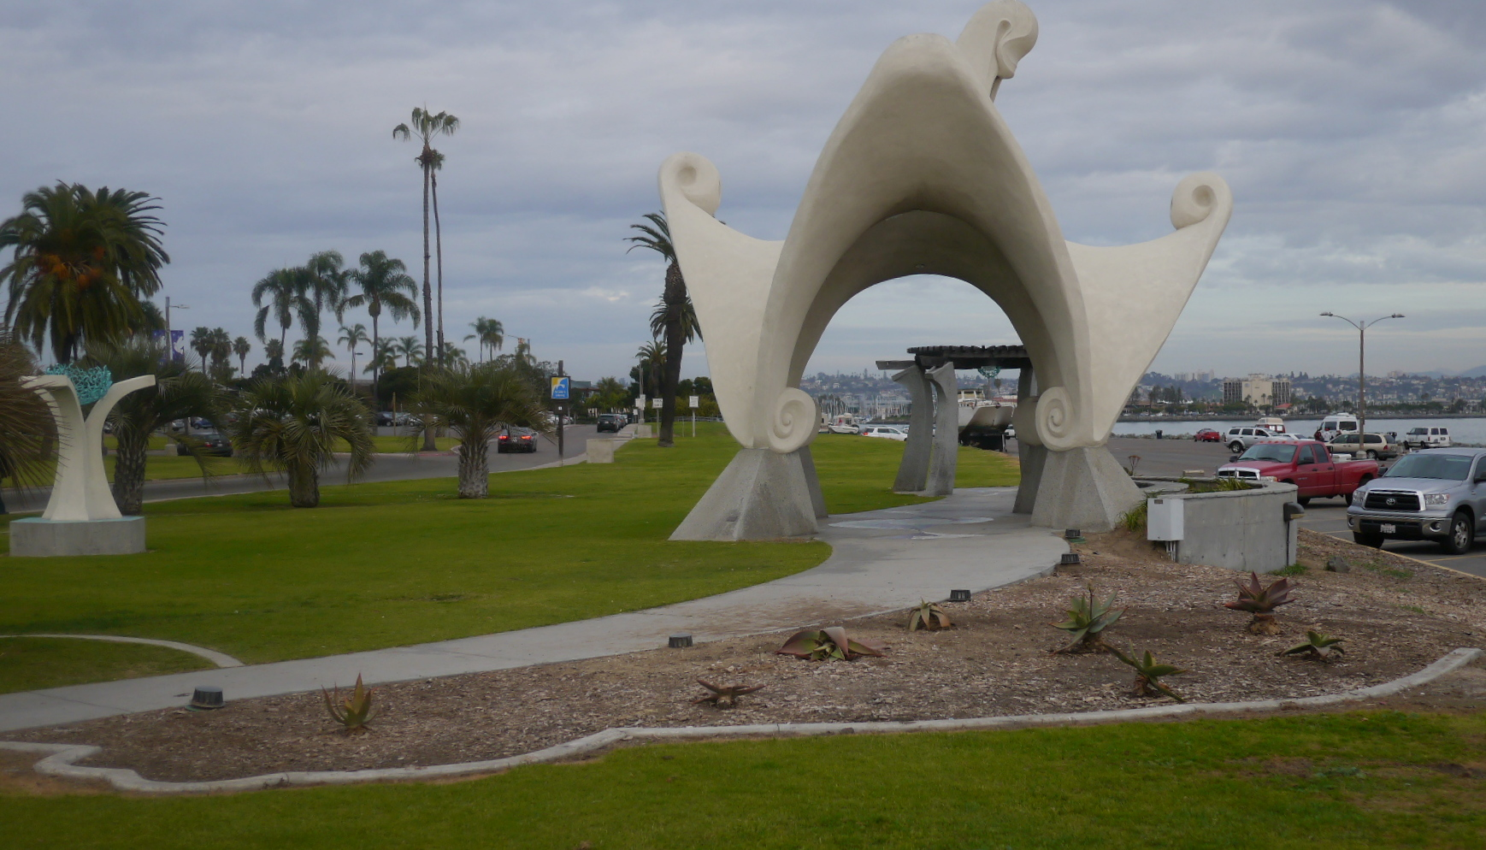
Pacific Portal, looking north.
South planting area.

Slide 5
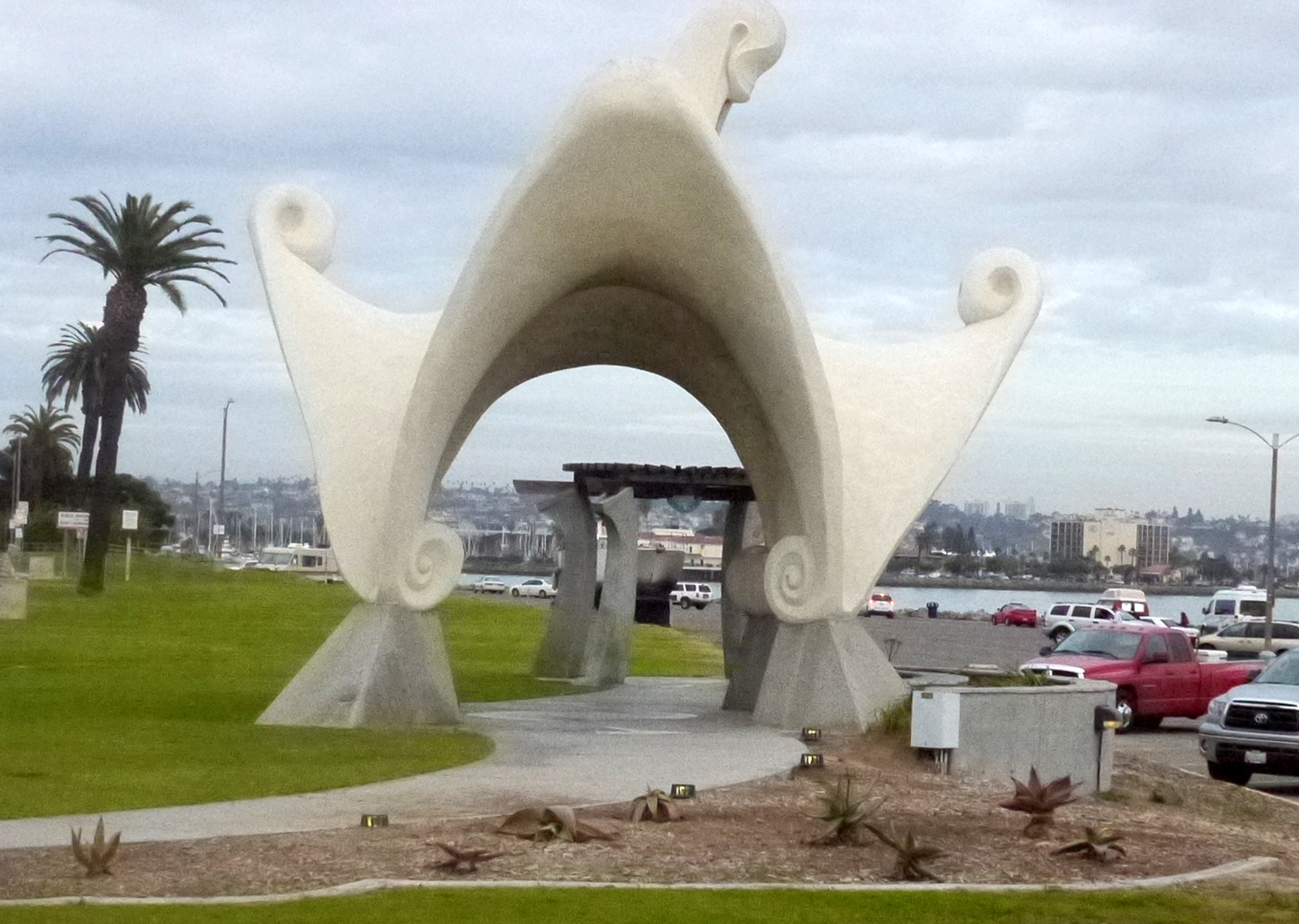

Slide 6
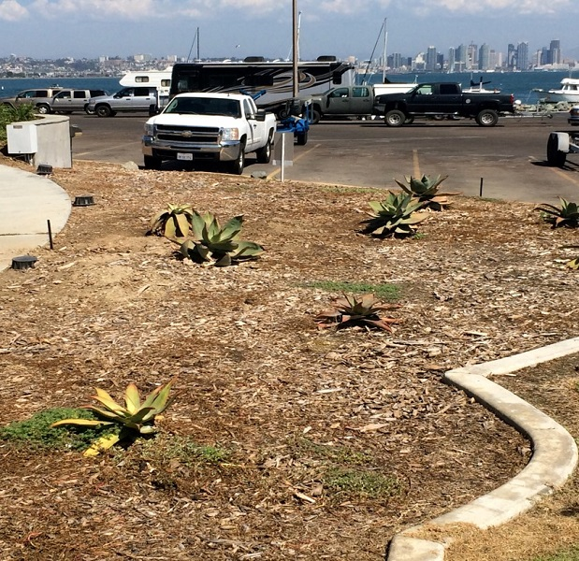
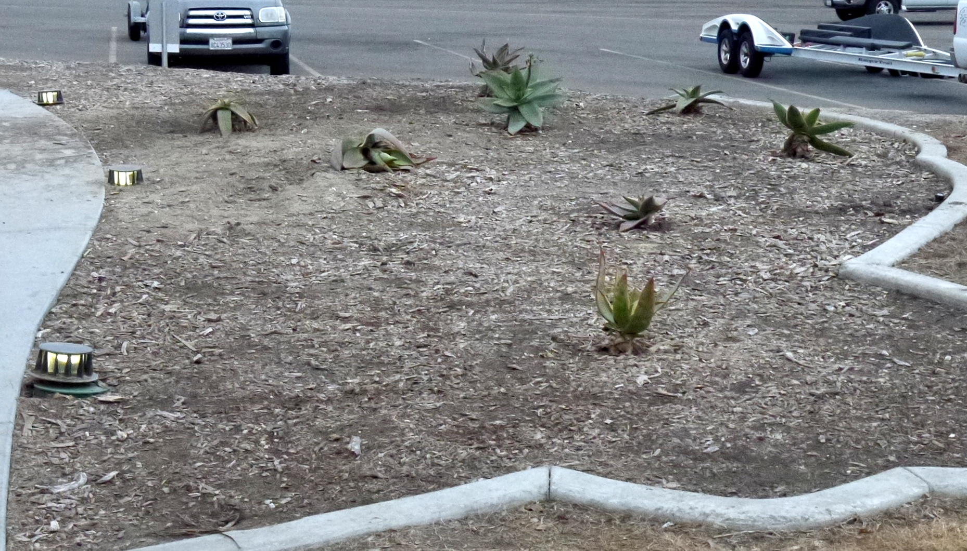
South planting area,
close up. Photos taken one month apart (day and evening).

Slide 7
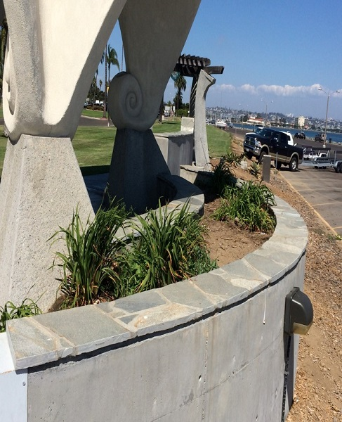
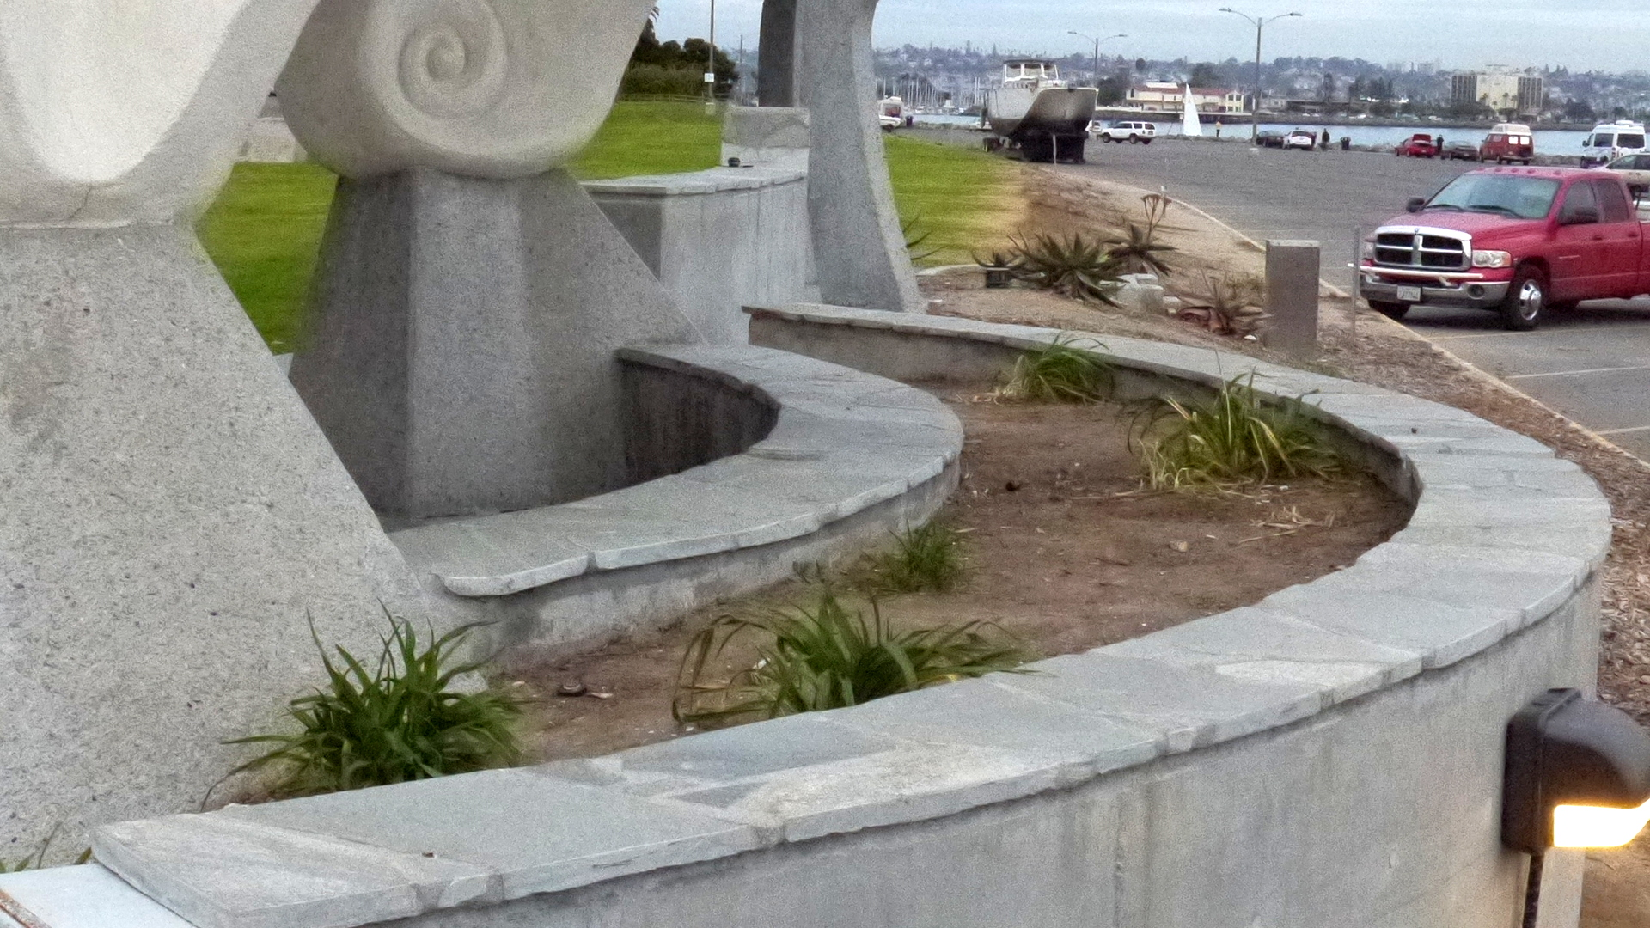
Covered planting area. Photos taken one month apart.

Slide 8
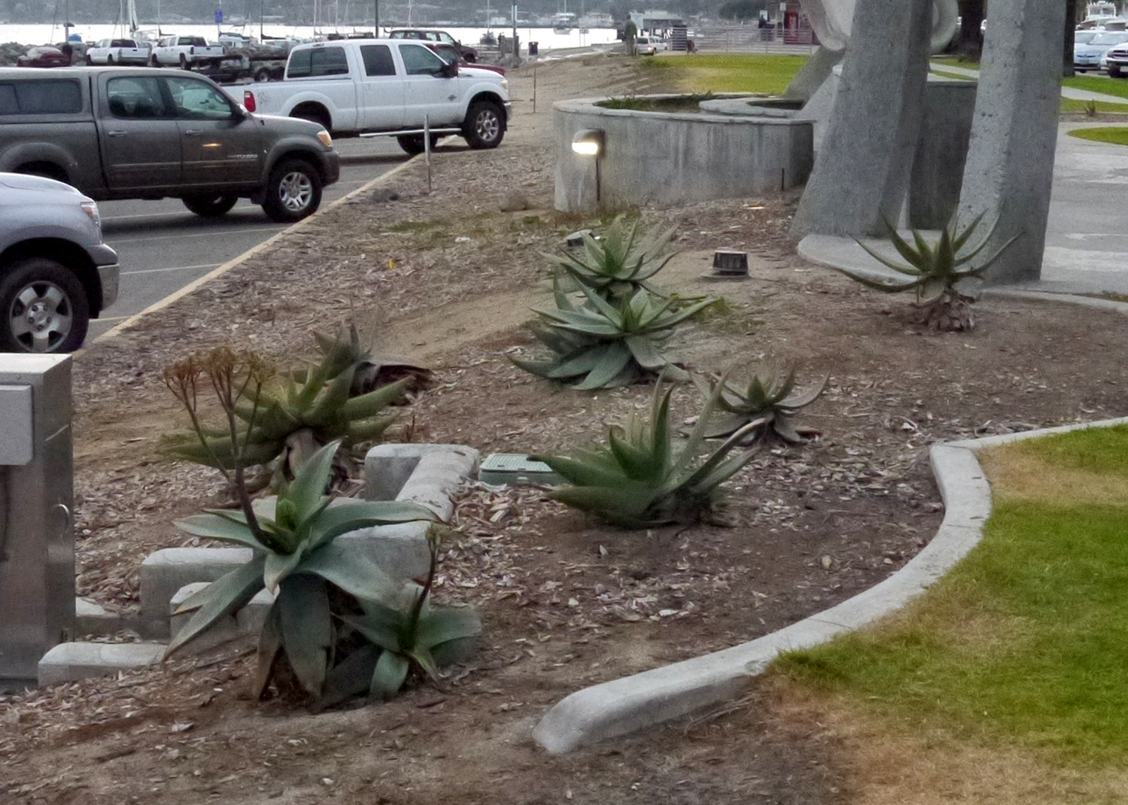
North planting area.

Slide 9
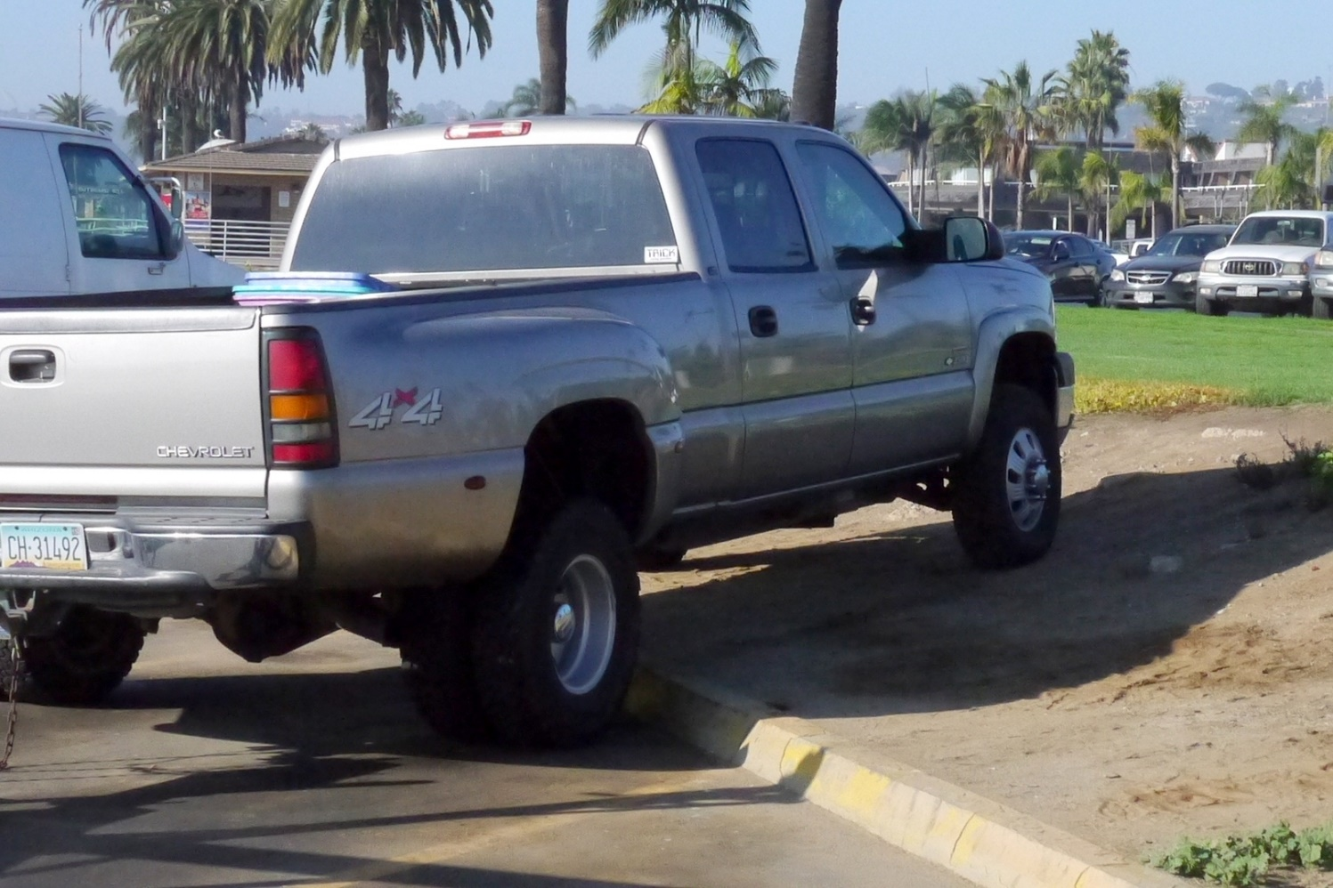
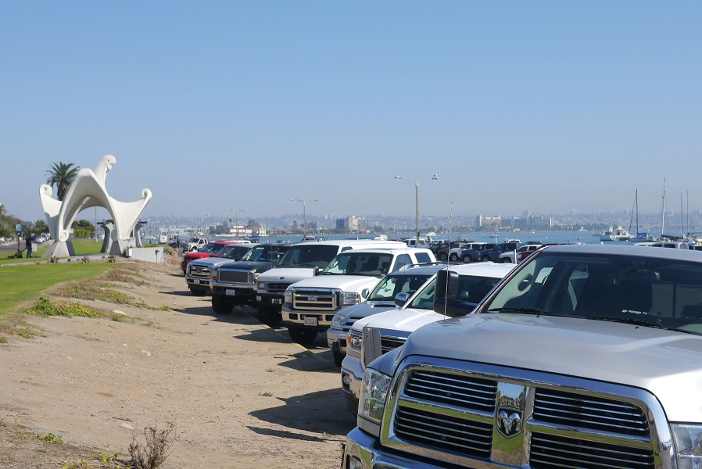
Parking at boat-launching ramp for trucks that pull boat trailers.
In order to keep trailers within parking spaces, truck drive over the curb, below planting areas.

Slide 10
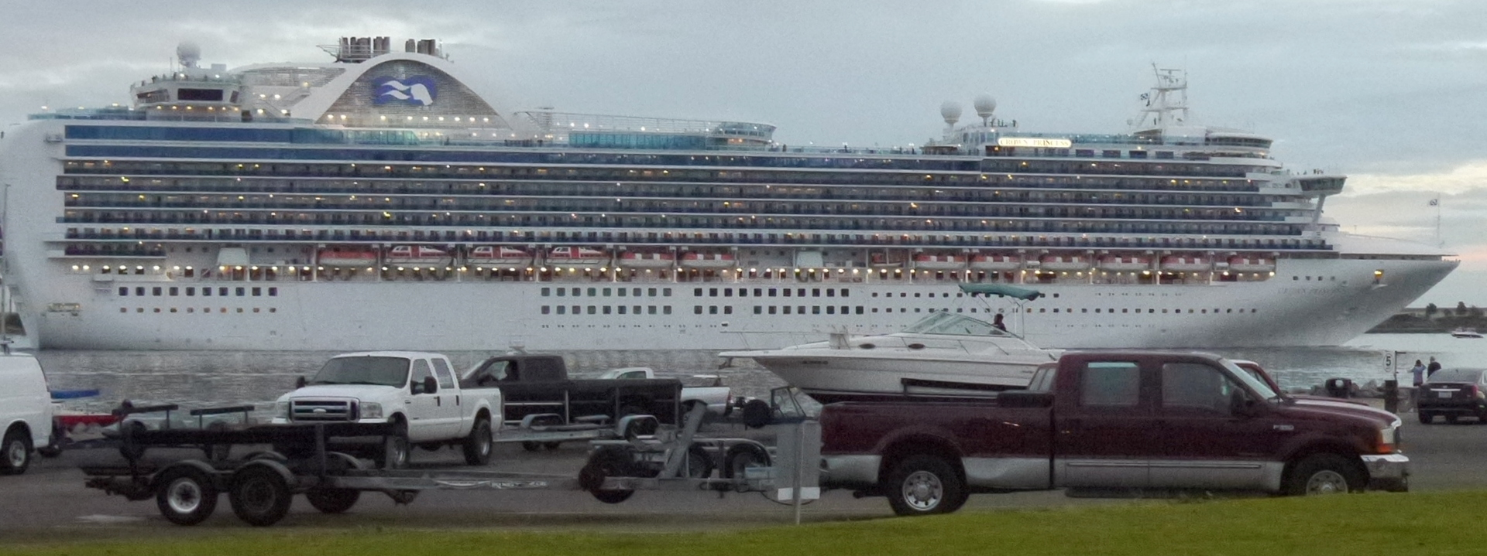
Tourists getting a look at Pacific Portal landscaping.

